Slide 1








UGC AUTONOMOUS
DEPARTMENT OF COMPUTER SCIENCE AND ENGINEERING
MINI PROJECT PRESENTATION
STRATEGIC RESOURCE INSIGHTS:
UNDERSTANDING AMERICA’S ECONOMIC RELIANCE ON NATURAL RESOURCES
PRESENTED BY
Vignesh Kumar(22RA1A05H6)
Shashi Pradeep(22RA1A05E6)
D Snehith(22RA1A05I9)
UNDER THE GUIDANCE OF
Mr. RITESH KUMAR
ASSISTANT PROFESSOR

Slide 2


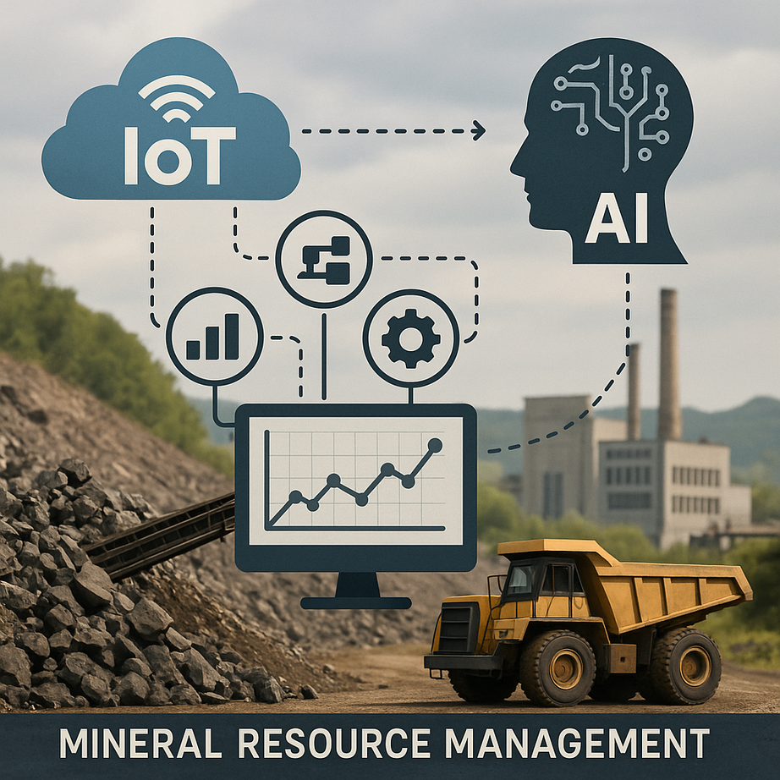
ABSTRACT
The integration of IoT and AI in resource economics marks a major shift in how the U.S. manages its dependency on critical minerals. Traditional systems relied on manual processes, lacked real-time insights, and led to inefficiencies and environmental impacts. This research proposes an IoT-enabled system, enhanced with machine learning, to monitor, track, and optimize mineral resource management. The system offers real-time data, predictive analytics, and automated decision-making, promoting sustainable extraction and efficient supply chains. Ultimately, it provides a smarter, data-driven approach to improving mineral usage and reducing waste, aligning with both environmental and economic goals.
STRATEGIC RESOURCE INSIGHTS: UNDERSTANDING AMERICA’S ECONOMIC RELIANCE ON
NATURAL RESOURCES

Slide 3


Traditional Resource Management
EXISTING SYSTEM
Manual and Semi-Automated Methods: Traditional mineral management relied on physical inspections, written reports, spreadsheets, and audits.
Fragmented Data: Data was siloed across departments, lacking centralized access or coordination.
Reactive Decision-Making: Decisions were based on outdated, historical data rather than current trends or predictive models.
High Human Dependency: Processes depended heavily on manual input, increasing the chances of human error and inconsistencies.
Limited Forecasting: Difficulty in predicting mineral demands or anticipating supply chain issues due to lack of analytics.
Weak Sustainability Tracking: Environmental monitoring was retrospective and not proactive.
Inflexibility: The system lacked agility, intelligence, and integration for modern sustainable resource management.
DISADVANTAGE-1
:
Lacked real-time data monitoring and analytics capabilities
DISADVANTAGE-2
:
No automation or
predictive decision-making
tools

Slide 4

PROPOSED
SYSTEM
The aim of Proposed system is to develop an intelligent, IoT-enabled, and AI-driven framework for sustainable natural resource management in the America by leveraging machine learning models—particularly Support Vector Classifier (SVC)—to predict, optimize, and monitor mineral extraction and supply chain operations with improved accuracy, efficiency, and environmental responsibility.
Data is preprocessed by handling missing values, removing redundant features, and applying standard scaling.
A Support Vector Classifier (SVC) is introduced as an improved model, leveraging kernel functions to capture complex,
non-linear relationships in the data.
SVC shows stronger generalization and robustness, validated on both internal and unseen datasets (testdata.csv).
Comparative metrics (accuracy, F1-score, confusion matrix) confirm SVC’s superiority in sustainability predictions.This approach demonstrates how AI and IoT-driven analytics can support smarter, more sustainable mineral management.
ADVANTAGE-1
:
✅ Improved Accuracy:
SVC captures complex, non-linear relationships, leading to more precise predictions.
ADVANTAGE-2
:
🔒 Reduced Human Error: Automation of data processing and predictions lowers reliance on manual input.
Notes:
4

Slide 5


SYSTEM REQUIREMENTS
SOFTWARE
HARDWARE
Python 3.7.6 version
Processor (CPU):
Minimum: 1 GHz single-core processor
Recommended: Dual-core or quad-core processor, 2 GHz or higher
Memory (RAM):
Minimum: 512 MB RAM
Recommended: 4 GB RAM or more (8 GB+ for data-intensive tasks)
Storage:
Minimum: 200 MB free disk space
Recommended: At least 1 GB free disk space (more for libraries, datasets, and environments)
Operating System Compatibility:
Windows: Windows 7 or later (32-bit and 64-bit)
macOS: macOS 10.9 or later
Linux: Compatible with most distributions (e.g., Ubuntu, CentOS, Fedora)
LIBRARIES
tkinter
PIL (Pillow)
Matplotlib
Seaborn
Pandas
Numpy
Scikit-learn (sklearn)
Imbalanced-learn (imblearn)
Joblib
PyMySQL

Slide 6

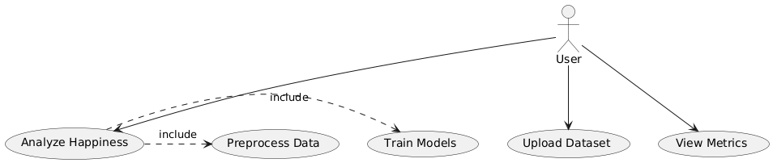


UML DIAGRAM
USE CASE DIAGRAM
This diagram maps out a data-driven application where the main goal is to analyze happiness, and the system supports that by allowing the user to upload data, preprocess it, train models, and view the evaluation metrics. The "include" relationships show that some actions are automatically required as part of higher-level processes.

Slide 7
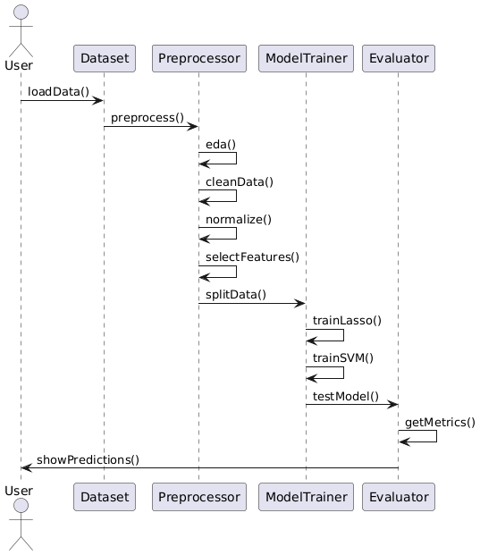
UML DIAGRAM
SEQUENCE DIAGRAM
This sequence diagram shows how a user interacts with components to load, preprocess, train, and evaluate a machine learning model. It outlines the step-by-step flow from data loading to final metric retrieval and prediction display.

Slide 8
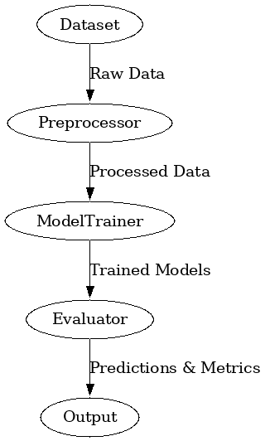
MODULES
1.User Interface Module
2.Dataset Module
3.Preprocessor Module
4.Model Trainer Module
5.Evaluator Module
6.Prediction Module
7.Model Persistence Module
Exploring creativity

Slide 9
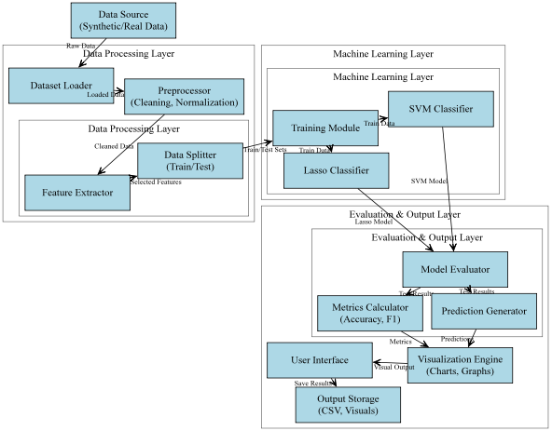
SYSTEM ARCHITECTURE
MAIN ROLES
1.User (End-User or Admin)
2.Dataset Manager
3.Model Trainer
4.Evaluator
5.Prediction Engine

Slide 10
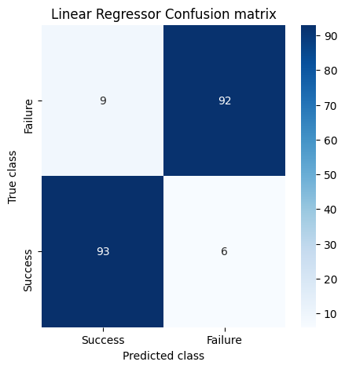
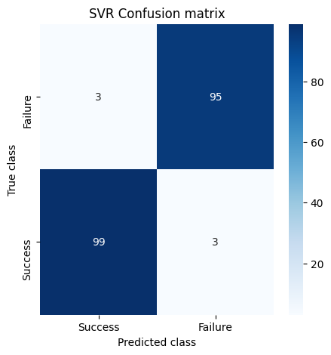
ALGORITHM
Machine Learning Algorithms
1.Logistic Regression
Used as a baseline model to classify sustainability outcomes based on mineral usage patterns.
It's simple, fast, and effective for linearly separable data.
2.Support Vector Classifier (SVC)
Captures complex, non-linear relationships in the dataset using kernel functions.
Ideal for improving prediction accuracy in sustainability classification.

Slide 11

CONCLUSION
This project presents an IoT-enabled machine learning framework to assess and improve America's critical natural resource management. By integrating diverse datasets—covering consumption, trade, emissions, recycling, and energy use—the system ensures clean and consistent input through rigorous preprocessing, scaling, and feature selection. Logistic Regression offers a baseline for classification, while the Support Vector Classifier significantly enhances accuracy, achieving up to 97% performance. The model enables
real-time monitoring and predictive insights, promoting sustainable decision-making. This intelligent, data-driven approach reduces environmental impact, optimizes resource utilization, and provides a scalable solution for sustainability-focused sectors
STRATEGIC RESOURCE INSIGHTS:
UNDERSTANDING AMERICA’S ECONOMIC RELIANCE ON NATURAL RESOURCES

Slide 12

Thank you very much!

